Slide 1
Centuries of Viziers
Digital storytelling in presentation of cultural heritage:
The case study of the Vizier’s residence in Travnik
Vanja Jovišić
Sarajevo School of Science and Technology

Slide 2
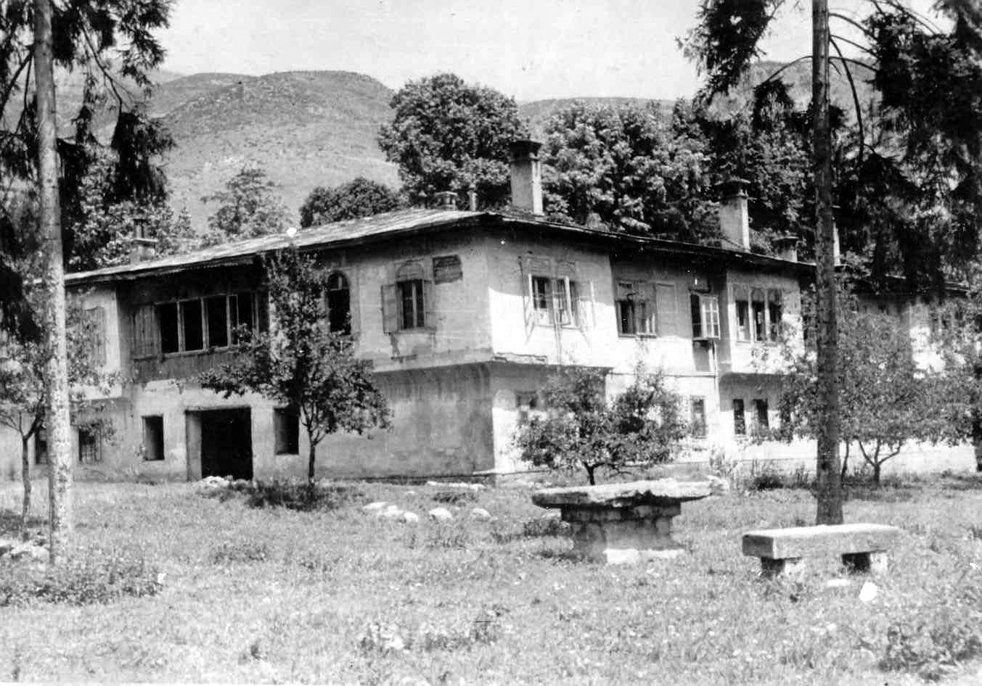
Konak in Travnik
Figure 1. Viziers Konak in Travnik, before it was torn down in 1950.
Notes:
Travnik became the administrative center of the Bosnian pashalik in 1699th and remained so until 1850. Although during the period of the 1699th to 1850th the central authority weakens and becomes unable to suppress resistance of the feudal lords all over the Ottoman Empire, Travnik was at the peak of its development. During the 143 years, that Travnik was capital, over 77 viziers have changed, 11 of which carried out this duty for several times. Among the major facilities built in the city was the Pasha's Palace or Viziers residence or Konak, built around 1749. Typical example of Bosnian house. In May 1950 it was demolished to the ground.

Slide 3
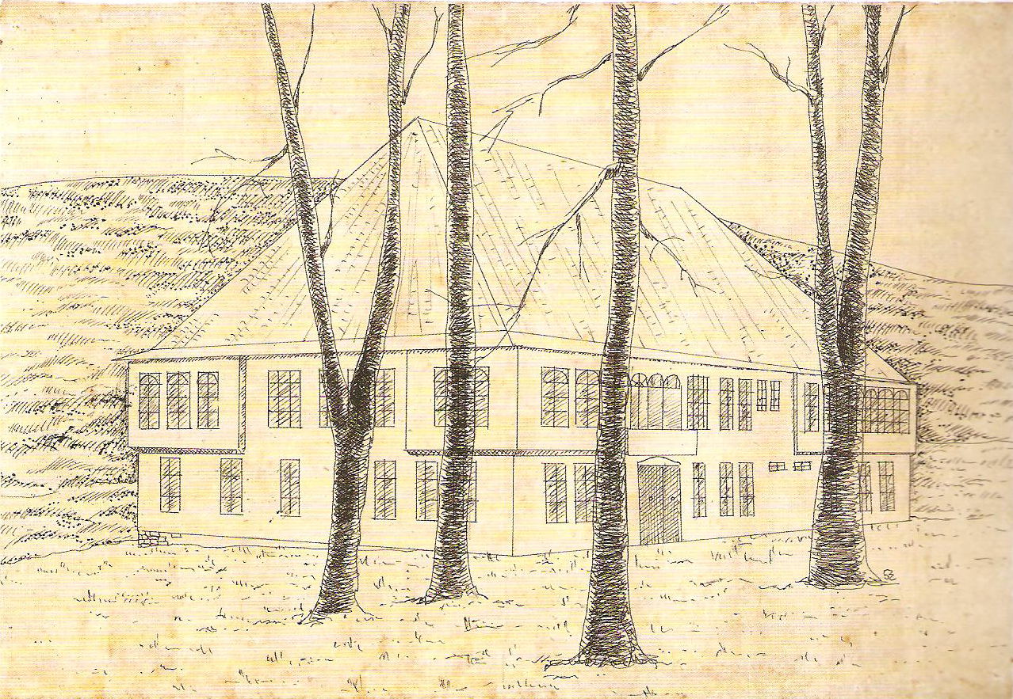
Goals
Revive the cultural value
Digitalize documentation about the residence
Figure 2. Artistic illustration of Konak
Notes:
Revive cultural value of the object by using digital storytelling techniques for presentational purposes in order to educate broader public who is usually unaware of importance of the monuments they cannot visualize.
Digitalize documentation about the residence, collect the available resources and make them easily accessible for the public. This documentation is used for creation of the digital story that is the final outcome of this project, but can also be used for creating digital stories about the residence in the following phases of the project. The fact that over 77 viziers have been ruling the country from this place for almost 150 years, and made decisions that directly affected our predecessors (and inevitably us), gives a lot of material for creating digital stories.
Final goal is to provide enough justification and tangible evidence for broad public to start perceiving the residence as an important part of our cultural heritage that should be more emphasized and put in the range of those examples of cultural heritage that have been wildly recognized and accepted. Its long-term ambition is to provide means (technical and financial) and inspire all future stories that will be reconstructed and told about the residence using different digital storytelling techniques.

Slide 4
Virtual heritage reconstruction
Protection
Historical research
Presentation to the broader public / Education
Notes:
Protection - The aim of this research is to identify the importance of specific heritage sites within its local, regional or universal values. Virtual reconstruction models successfully provide evaluation of different concepts and statements provided by the archaeologists.
Historical research - Virtual reconstruction of cultural heritage allows the visualization of complex data used for testing and refinement of created images or models. It is perceived as a simulation that allows investigation of the model in unrestrictive way in three dimensions and from many perspectives. In addition, it is possible to objectively verify all interpretations of architecture, materials used, topography, environment data, previous reconstructions, est. Analytical characteristics of representative reconstructions depends on how much is its creator devoted to this segment. It is necessary that the reconstruction was performed by clearly specified and predefined way, depending on the available data. Model reconstruction should be part of research objectives and answer the question in the research process.
Presentation to the broad public/education - The basis of this research is to discover how to explain the original, unique value of historical monuments to the broad public. The emphasis is on the realism and ease of use. This includes providing access to the generated content, from computer networks to AR. Although the precision and accuracy of these applications are often questionable, this type of research promotes the idea that all the information collected and presented should be based on trustful sources of data and their processing, and that hypothetical elements in reconstruction should adequately be based on verifiable facts.

Slide 5
Aproach
Using:
Wildly accepted architectural visualization techniques to achieve rich quality visualization
Digital storytelling techniques to create visually appealing digital story

Slide 6
Problems faced
Lack of data
Photographic data
10 images of exterior shoot on the day when object was torn down
1 image of interior
Graphical data
3 main data sources for the project are:
Incomplete
Belong to the different periods in a history
Textual data
Very poor resource
Over 20 different paragraphs of text from different authors and period

Slide 7
Solutions
Data acquisition
Patience
Persistence
Multidisciplinary approach
Transparency
Data sources
Data processing methods
Hypothetical elements

Slide 8
Requirement definition and specification
Input data
3 sets of architectural plans of the objects
Written, oral and photographic data collected
Existing examples to be used as the reference
(Svrzo ’s House, National Museum, Bišćevića’s House)
Tools used
AutoCAD 2010 – Digitalization of the architectural plans
3ds Max – Modeling, Texturing, Illumination, Animation, Rendering
Postproduction and editing– Adobe Studio CS3 (After Effects and Premiere Pro)

Slide 9
Project Phases
Data collection
Writing historical background of an object
Modeling
Exterior of the residence
3D site
Interior and furniture of the residence
Notes:
Modeling of interior room(s) and furniture that could be usually seen in the objects (accomplished in cooperation with architects, historians and museum workers)

Slide 10
Modeling preparation
Digitalized (in AutoCAD format) and consolidated available architectural plans
Goal:
Creating the most probable representation of the original object based on the oldest plans
Notes:
The oldest documentation about the residence dates back to the 1897, in the period of Austro-Hungarian administration, when Dr. Rudolf Meringer recorded state of the building, described its layout, and defined its similarities with other examples of the typical Bosnian architecture of the Ottoman period (Meringer, 1901). Comparing these architectural drawings with those latest, made in 1947th, we can notice that the old roof was replaced, while the original layout was largely preserved (Kreševljaković, 1956, p.16). Some of the rooms got a new purpose; some were reconstructed by removing some indoor walls and windows from facade.

Slide 11
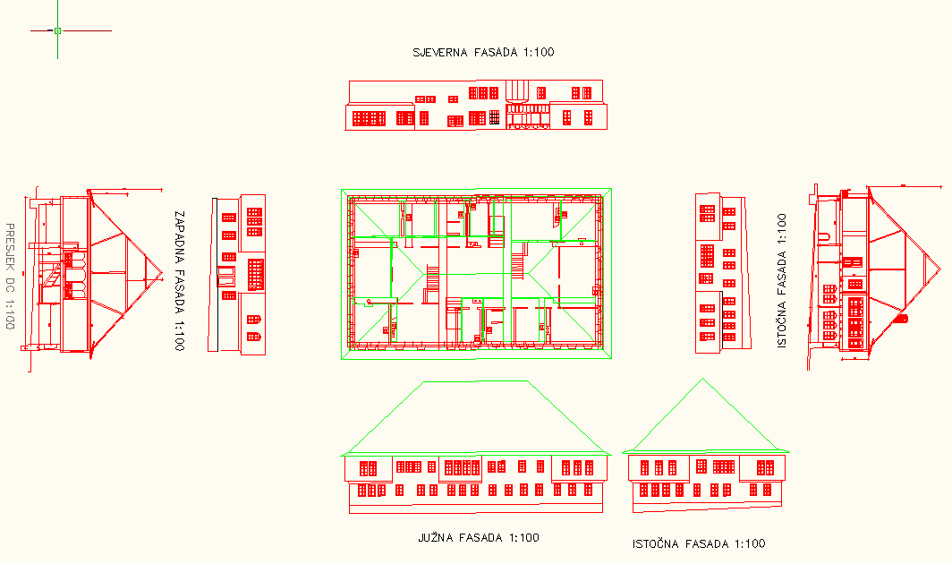
Modeling preparation
Cleaned AutoCAD line work and prepared for modeling in 3ds Max
Figure 3. AutoCAD linework

Slide 12
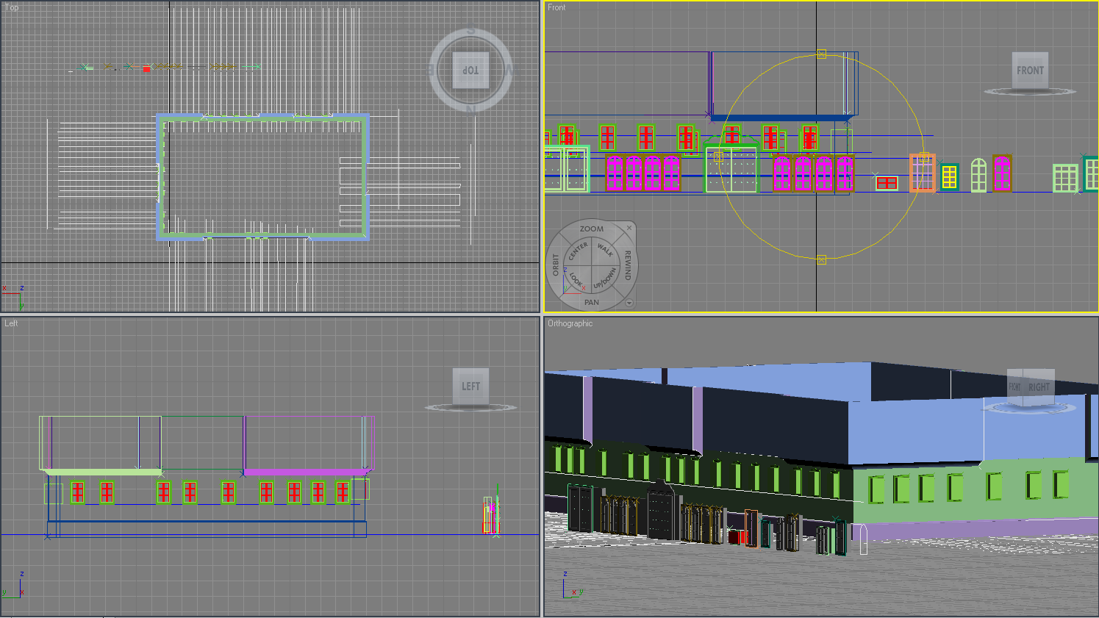
Modeling method – Loft +ProBoolean
Figure 5. Walls, windows and doors in position

Slide 13
Other steps in creation of a 3D object
3D site modeling based on the map from 1958
Light setup
Texturing
Setting up animation paths
Rendering

Slide 14
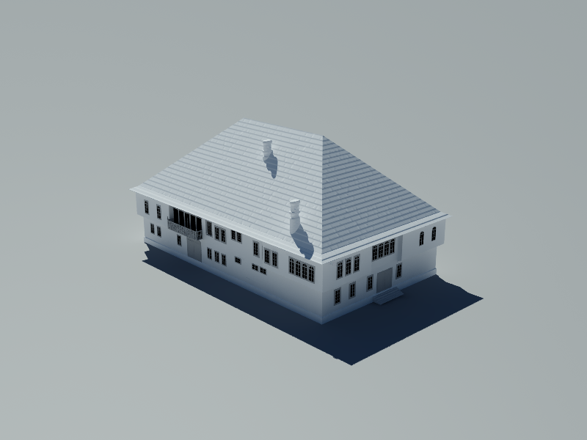
Renderings

Slide 15
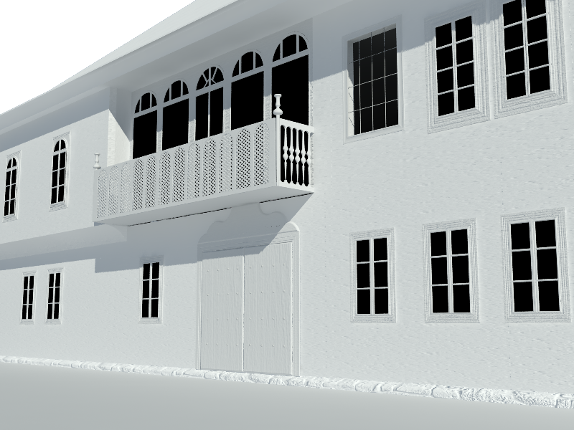
Renderings

Slide 16
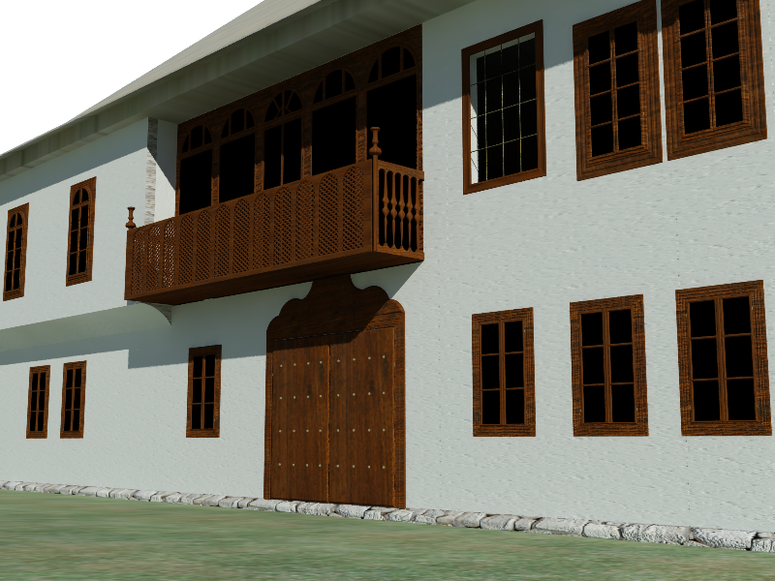
Renderings

Slide 17
Renderings

Slide 18
Other Phases
Writing storyboard
Writing shooting script
Audio recording and editing
Animation of cameras according to the script
GI Rendering
Postproduction and editing
Verification
Testing
Evaluation
Dissemination
Promotion

Slide 19
Stories
Stories - intangible elements of cultural heritage
Stories – important part of human culture
Stories – convey information, experiences, ideas and cultural values
Notes:
Stories have been told trough all periods of human culture and different inventions trough the history of humankind gave different means to tell them (Glassner, 2004). Stories have always been used to convey information, experiences, ideas and cultural values. Digital storytelling has been used to communicate that information (a story) to the user of the virtual environment, because stories have been an important part of all human culture.
In cultural heritage, stories were often told in form of historical narrative. Traditional historical narrative has developed from ancient storytelling (Kós, 2004). Nevertheless, old, proved practices and theories are often applied to new media, resulting in new ways of expression.

Slide 20
Digital storytelling
Emerged in 1990’s
Using digital media to create short audio-video pieces telling people’s stories
Forms
Linear, pre-rendered sequences
Interactive storytelling
Notes:
Digital storytelling technique has emerged in 1990’s when the first Center for Digital Storytelling (CDS) was established as the main organization associated with new media practice. It started as a workshop-based practice in which people were taught to use digital media to create short audio-video stories, enabling ordinary people to tell the important stories of their everyday lives (Hartley & McWilliam, 2009, p. 7).
This practice has now been used worldwide, in many different contexts and forms. Digital storytelling has been used in broadcast, education, for marketing purposes, as a tool for evaluation and research. The original model of digital storytelling has to be modified in order to be used in cultural institutions as there is a need for much better collaboration of many people in production of this type of ‘micro documentary’. Focus is shifted from self-expression to interactivity and distribution possibilities of Web 2.0 platforms

Slide 21
Development of a digital story
Story content – screenplay created from the gathered facts
Visual design - character placement, lighting, camera movements
Audio channel
Notes:
The story about the residence opens with a scene showing the present state of the site where the residence used to be. This scene has an aim to intrigue the audience and raise expectation. Then the audience follows the story about the building from the moment it became the residence until the moment it was destroyed. Story tries to interpret visually how the building looked like, why it was important and what happened to it at the end. Final scene leads the audience back to the present where there is no answer to the question why the building was demolished. The audience should seek this answer afterwards, it should eventually make them think about what happened and search for responsibilities.

Slide 22
7 elements of digital storytelling
Point (of view)
Dramatic question
Emotional content
The gift of your voice
The power of the soundtrack
Economy
Pacing
Notes:
There are seven basic elements of digital storytelling (Lambert, 2006).
A point (of view) – it is a central premise of a story we are trying to tell.
A dramatic question – In order to keep the attention of the audience throughout the story, there is a need for using a classical desire-action-realization model.
‘A story follows an interesting protagonist seeking a clear goal by addressing an ever-escalating set of difficulties’.
In digital storytelling, a term ‘dramatic question’ is used instead, and each digital story should be based on a central question that is answered at the end of the story.
By applying these three dimensions to the residence as a character, we can reach the audience in different ways:
Physicality - characteristics of the building are shown trough its shape, form, position in the environment
Psychology - mood and feeling evoked by visual contact with the residence, enhanced trough colors, light, textures used
Society – this relationship is communicated through the audio channel, by using different sounds and voices of people in some areas, pointing out how my character interacts with people (or the opposite).
Emotional content – The story should be able to engage the audience emotionally.
The gift of your voice – Besides using images, videos and music as elements for the story, voice-over adds another channel of information to it.
The power of the soundtrack – Music plays an important role in perception of visual information.
Economy – The story should be effectively illustrated with as small amount of visual material as possible.
Pacing – The rhythm of the story determines how long the audience will pay attention to a story.

Slide 23
Evaluation
Form of digital storytelling used – linear storytelling
Positive sides
Familiar experience
More focus on the story
Negative sides
Author controls users’ experience
Realism could be misleading
Notes:
The public is presented with reconstructions of ancient sites, but has neither the means nor the desire to question their scientific quality now that technology can produce images almost as good as photographs.
Unfortunately, all these measures of precaution during the process of creating authentic and accurate virtual reconstructions of the past always give result that is abstracted from the real life and rarely virtual reconstructions permit later interpretation or change, which is criticized by many authors (Bharat, 2008).
Despite these reservations and unresolved issues, more and more scientists are using virtual reconstructions because they consider that any mean of representation inevitably leads to possibility of misinterpretation of data. These drawbacks are outweighed by the advantages of increasing public awareness of world heritage and the importance of protecting it. Others perceive this as a way to gain knowledge about the reconstructed site and as yet another interpretation of the information, which can be replaced by new interpretation, a new 3D model.

Slide 24
Evaluation survey
Set of questions about the monument asked before and after watching the digital story

Slide 25
Survey examples

Slide 26
Survey examples

Slide 27
Conlcusion
Importance of the INTERDISCIPLINARY approach

Slide 28
Thank you
Questions?

